Slide 1
PETSTORE API
Group Members:
Shubham Agarwal, Tushiqa Malik, Yash Paliwal, Alia Syed

Slide 2
API Used:
PETSTORE API
Sample server Pet Store server.
Used to find everything about your pets.
Various requests
Upload an image of the pet.
Add a new pet to the store.
Update an existing pet.
Find pets by status.
Find pet by ID.
Updates a pet in the store with form data.
Deletes a pet.
Link to the API: Swagger UI

Slide 3
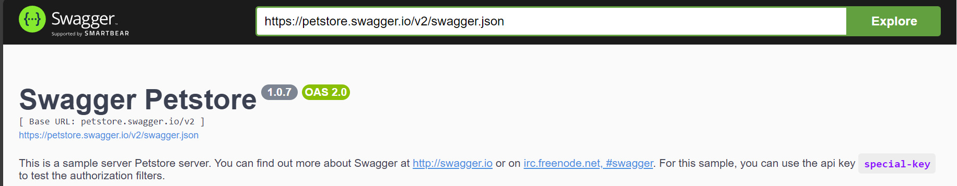
Base URL:

Slide 4
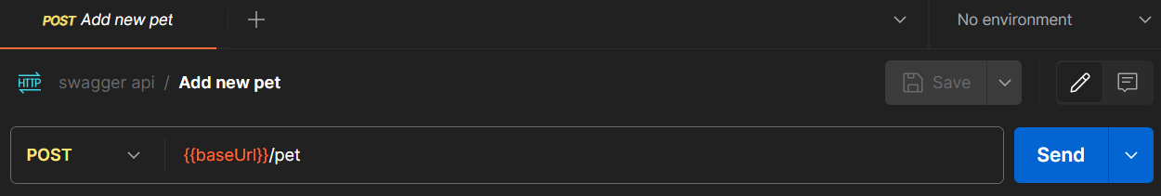
Activity 1
Add Pet with the following details:
ID: Last 4 digits of your IBM id.
Name: Your name
Status: Add a creative status

Slide 5
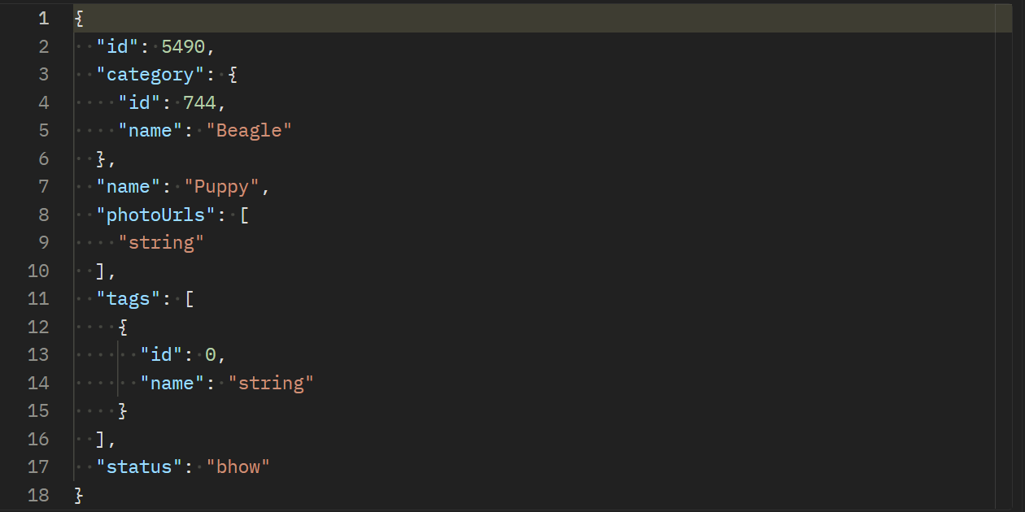
Body:
Results:

Slide 6
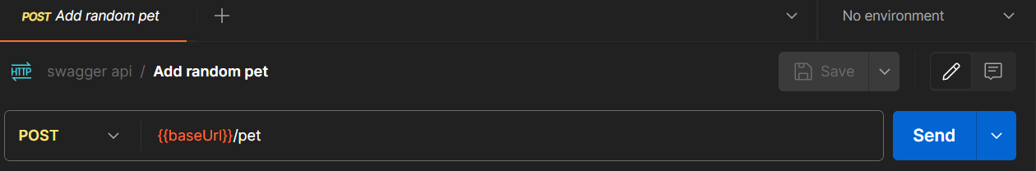
Activity 2
Add Pet with the following details:
ID: Randomized id

Slide 7
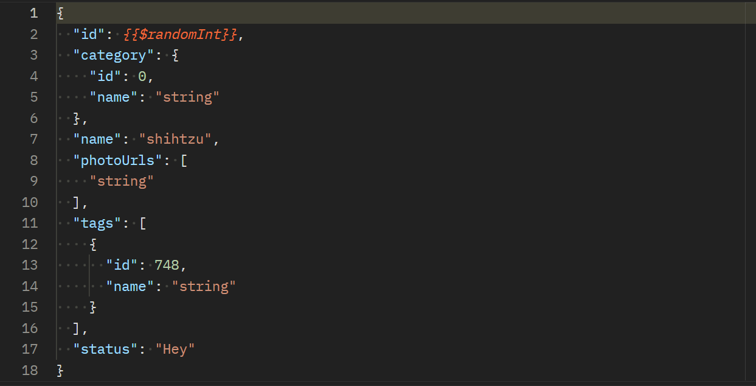
Body:
Results:

Slide 8
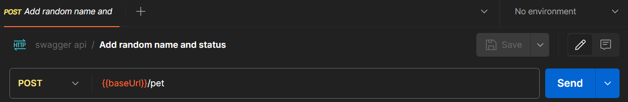
Activity 3
Add Pet with the following details:
ID: Randomized id
Name: Randomized name
Status: Randomized status

Slide 9
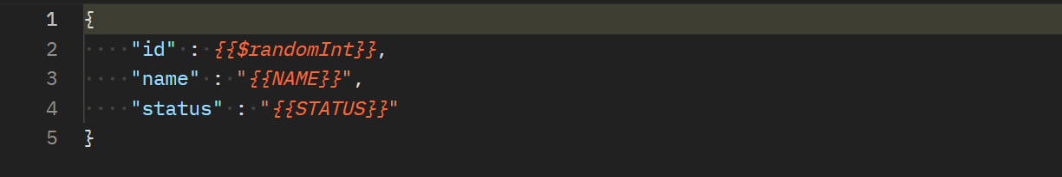
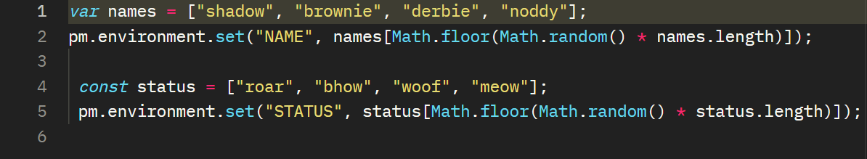
Body:
Pre-request script:
Results:

Slide 10
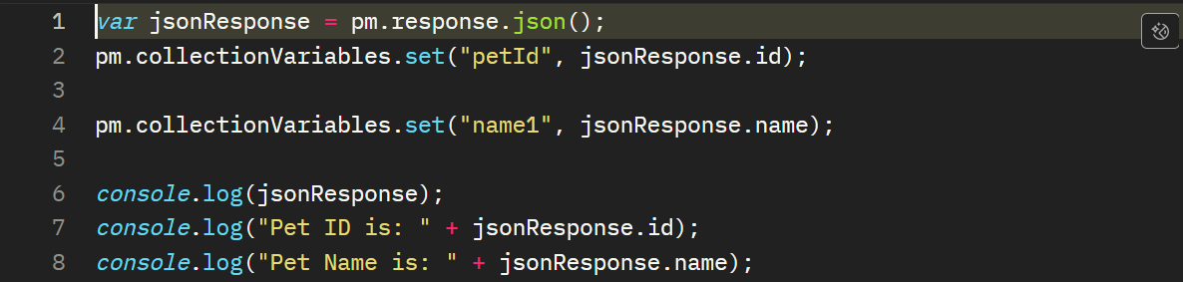
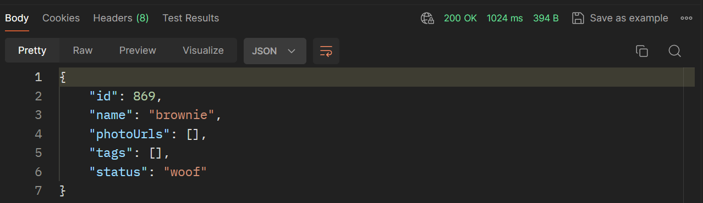
Tests:
Results:

Slide 11
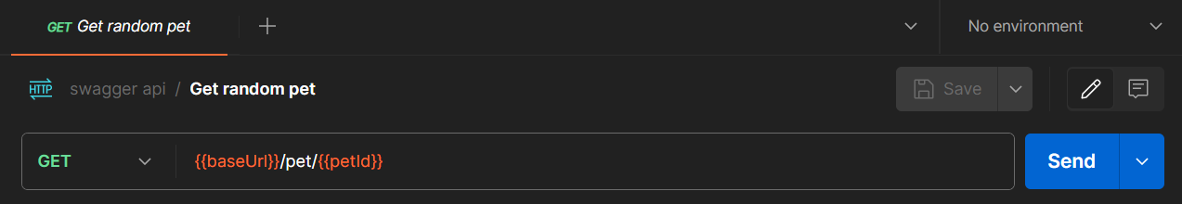
Activity 4
Run a GET request for the pet created above to get the details of the pet created, using the pet id.

Slide 12
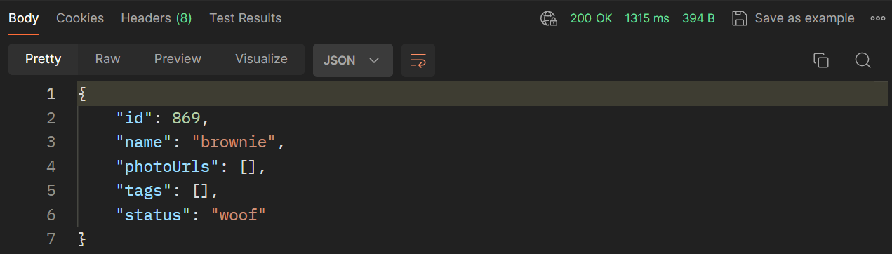
Results:

Slide 13
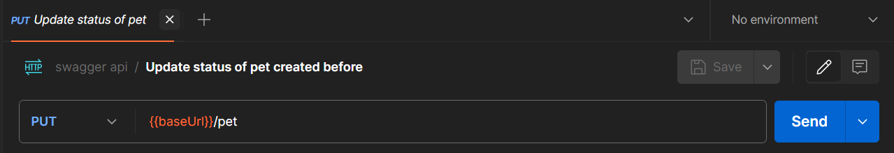
Activity 5.1
PUT request to update the status of the pet created above.

Slide 14
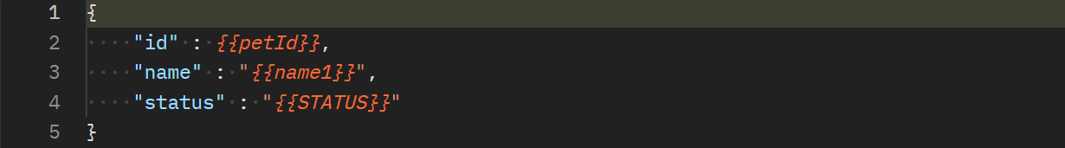
Body:
Pre-request script:
Tests:

Slide 15
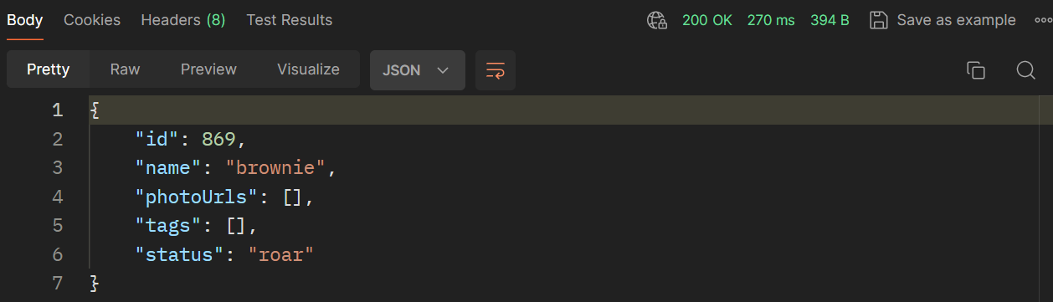
Results:

Slide 16
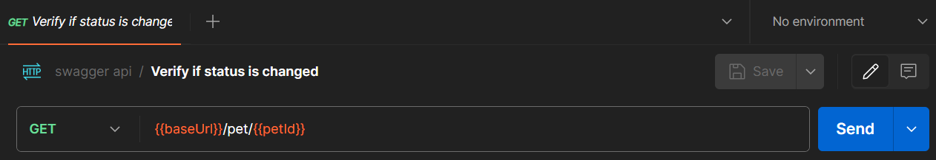
Activity 5.2
GET request to verify if the status of the pet created above has really changed.

Slide 17
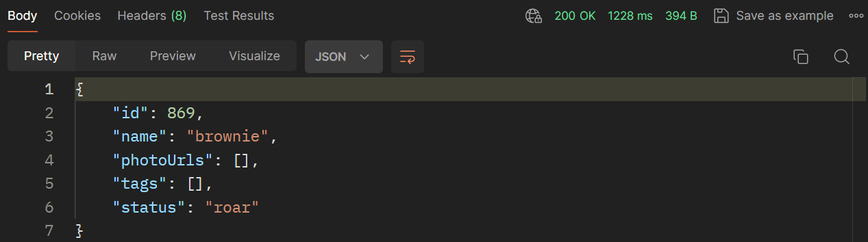
Tests:
Results:

Slide 18
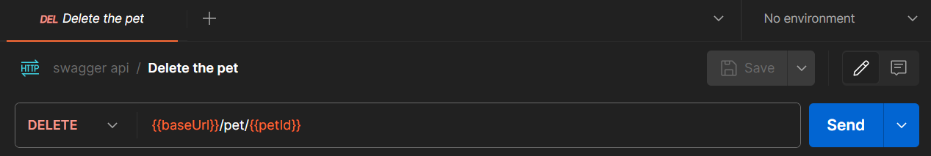
Activity 5.3
DELETE request to delete the pet.

Slide 19
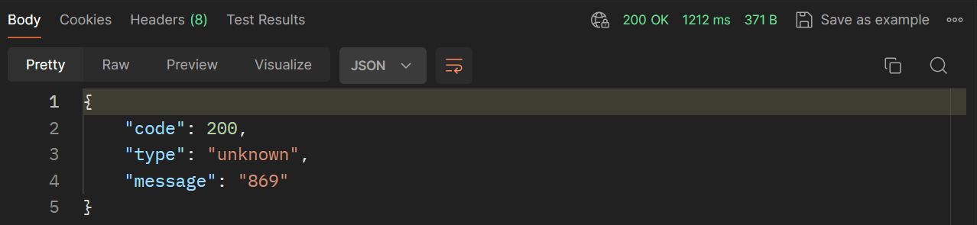
Results:

Slide 20
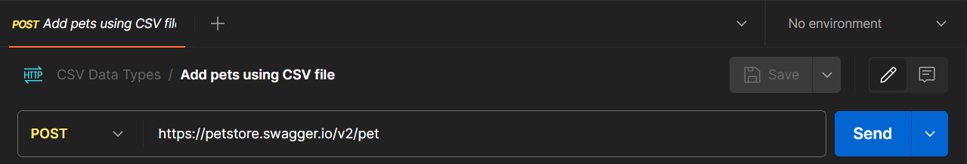
Activity 6
Create a CSV file with the test data.
Use the CSV test data to create POST requests.
Use console.log to write the data being used during each request.

Slide 21
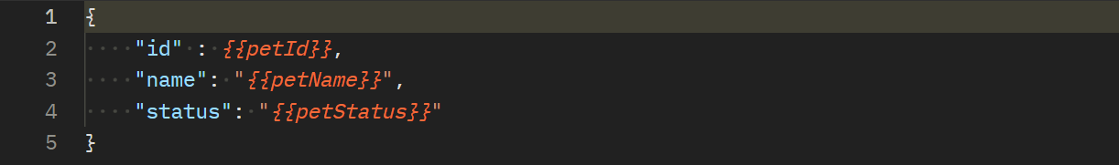
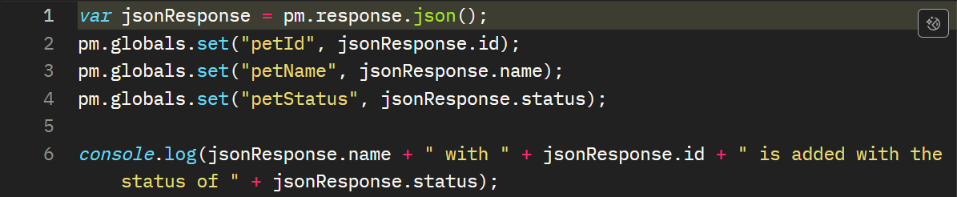
Body
Tests:

Slide 22
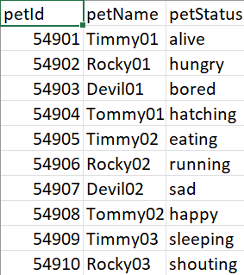
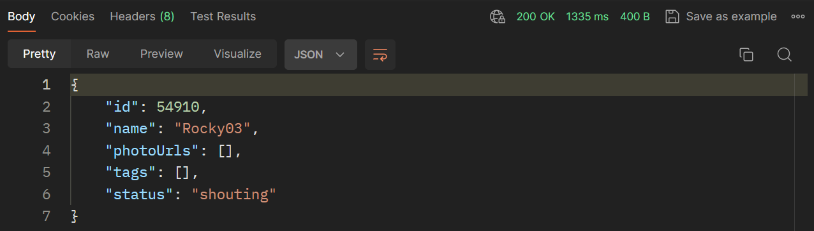
CSV file:
Results:

Slide 23
THANK YOU

